Slide 1


FAIR Digital Objects
Bringing People Together to Advance Data Science!
EUDAT Garching Meeting
Peter Wittenburg
Max Planck Computing & Data Facility

Slide 2
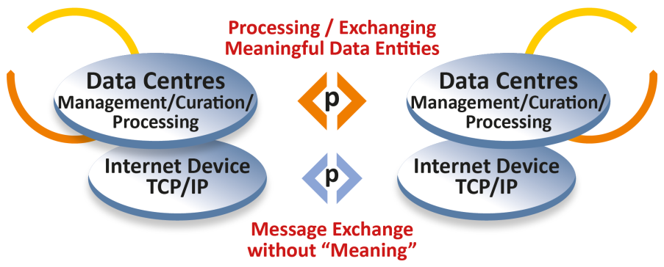

Internet at the start
some
applications
FTP
SMTP
GOPHER
etc.
82/85
complex,
many different types,
scientifically driven
„simple“, few types,
technologically driven

Slide 3
Web came next
some
applications
many
applications
FTP
SMTP
GOPHER
etc.
WWW
HTTP
HTML
URI
91/94
82/85
complex,
many different types,
scientifically driven
„simple“, few types,
technologically driven

Slide 4
Handles little later
some
applications
many
applications
Handle
System
FTP
SMTP
GOPHER
etc.
WWW
HTTP
HTML
URI
92/96
91/94
82/85
complex,
many different types,
scientifically driven
„simple“, few types,
technologically driven

Slide 5
Kahn&Wilensky Papers
10/12
DO
Architecture
some
applications
many
applications
Handle
System
FTP
SMTP
GOPHER
etc.
WWW
HTTP
HTML
URI
A Framework for
Distributed Digital
Object Services
(Kahn & Wilensky)
92/96
91/94
82/85
95/06
complex,
many different types,
scientifically driven
„simple“, few types,
technologically driven

Slide 6
1st Applications of Handles
10/12
DO
Architecture
02
„large“
repositories
some
applications
many
applications
Handle
System
Publishers
DOI
FTP
SMTP
GOPHER
etc.
WWW
HTTP
HTML
URI
A Framework for
Distributed Digital
Object Services
(Kahn & Wilensky)
92/96
02/12
91/94
82/85
95/06
complex,
many different types,
scientifically driven
„simple“, few types,
technologically driven

Slide 7
RDA came in
14
RDA DFT
Core Model
10/12
DO
Architecture
02
„large“
repositories
some
applications
many
applications
Handle
System
Publishers
DOI
FTP
SMTP
GOPHER
etc.
WWW
HTTP
HTML
URI
A Framework for
Distributed Digital
Object Services
(Kahn & Wilensky)
92/96
02/12
91/94
82/85
95/06
complex,
many different types,
scientifically driven
„simple“, few types,
technologically driven

Slide 8
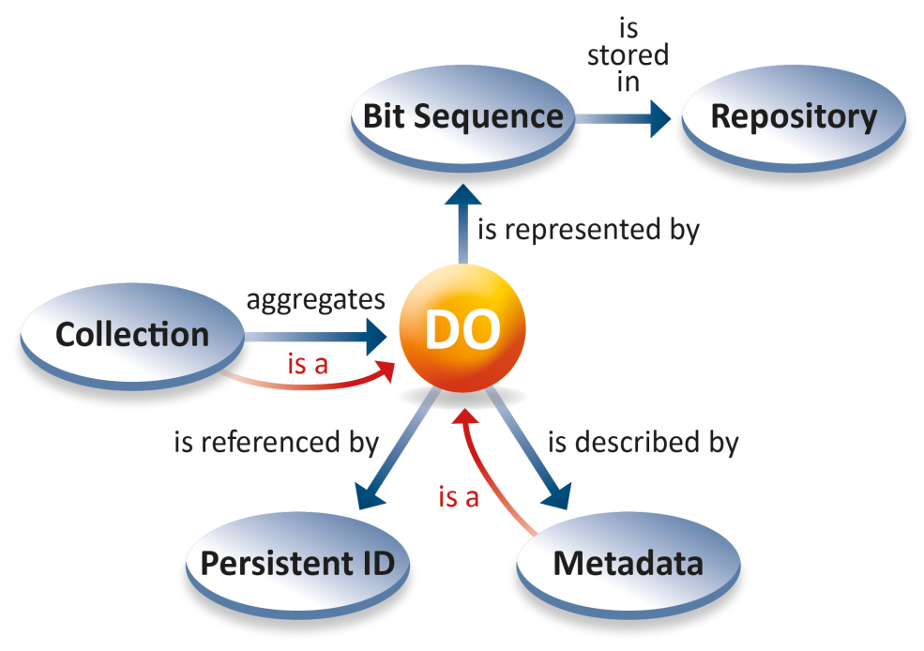
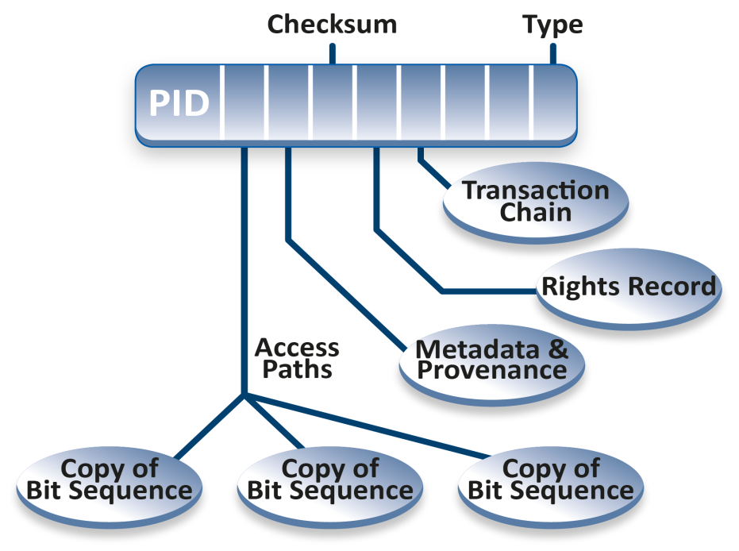
RDA Data Foundation & Terminology (2014)
Kahn & Wilensky: DO is an instance of an abstract data type that has two
components, data and key-metadata. The data is typed. The key-metadata includes
a handle.
RDA
Kernel
DTR
DFT: a DO has a structured bit sequence stored in some repositories, is assigned a
PID and is described by metadata. DOs can be aggregated to collections which are also DO. Metadata descriptions are DOs.
The DO‘s PID Record is resolved to machine-actionable attributes enabling human/machine actions.

Slide 9
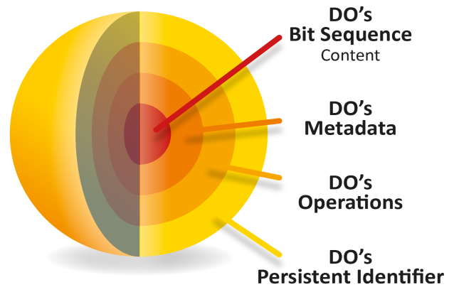
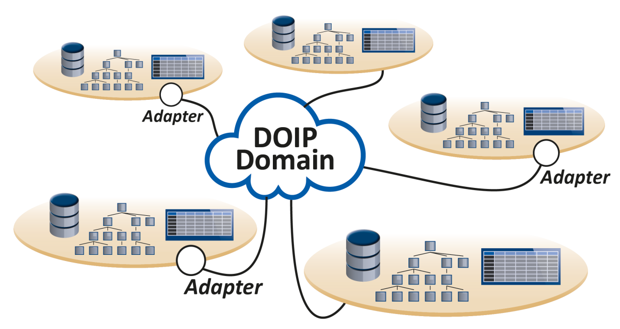
DOIP V2.0 from DONA
improved specification and implementation of DO Architecture
DOIP V2.0 specifying unified client – DO Server interaction
CORDRA reference implementation ready
DOIPV2.0 SDK almost ready
all based on PIDs
abstraction
binding
encapsulation

Slide 10

The FAIR Rocket
14
RDA DFT
Core Model
10/12
DO
Architecture
02
„large“
repositories
some
applications
many
applications
Handle
System
Publishers
DOI
FTP
SMTP
GOPHER
etc.
WWW
HTTP
HTML
URI
A Framework for
Distributed Digital
Object Services
(Kahn & Wilensky)
92/96
02/12
FAIR F1
91/94
82/85
95/06
complex,
many different types,
scientifically driven
„simple“, few types,
technologically driven
do DOs fully support FAIR?

Slide 11
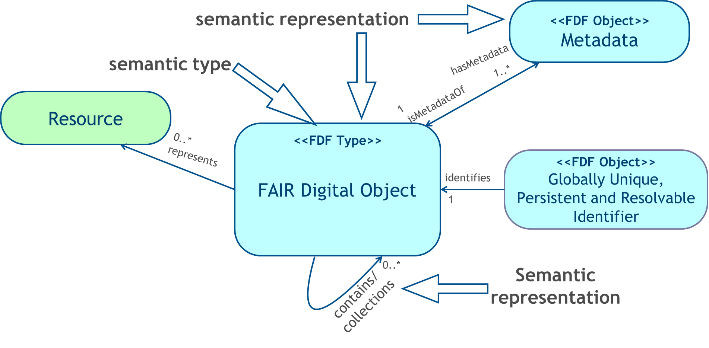

FAIR requires Semantic Explicitness
(in close collaboration with Luiz Bonino and by borrowing mechanisms from LD)

Slide 12
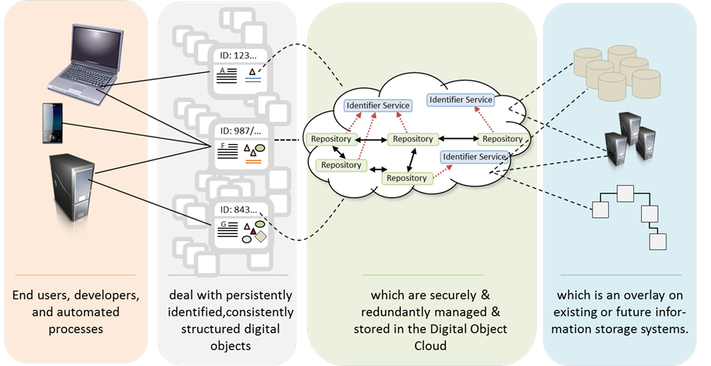
clouds
files
hsm
dbs
etc
What does it solve?
virtualisation
local
virtualisation
VREs, Search
etc.
mikro
procedures
DOIP
FDOs are an integrative technology for federative infrastructures!

Slide 13
FAIR DO Framework (Draft)
could be several implementations (DOA, LDP, DBMS, etc.)
General Guidelines
We can mention a few overall guidelines that need to be met by the FAIR DO Framework (FDOF). FDOF needs to
G1: show a path for infrastructure investments for many decades
G2: demonstrate trustworthiness to researchers and developers to become engaged
G3: offer compliance with the FAIR principles being turned into indicators of FAIRness
G4: support machine actionability which includes referential integrity, which states that all references need to be valid without temporal limitation, and explicitness of semantic relationships
G5: support the abstraction principle, i.e. abstract away from details that are not needed at a specific layer such as at management layer there is no difference to be made between data, metadata, software, semantic assertions, etc.
G6: support stable binding between all informational entities that are required for machines to act
G7: support encapsulation which means that operations can be specified by types
G8: support technology independence allowing implementations using different technologies

Slide 14
FAIR DO Framework
FDOF1: A PID, standing for a globally unique, persistent and resolvable identifier, is assumed to be the basis of the Internet of FAIR Data and Services.
FDOF2: A PID is resolved to a structured record with attributes which are semantically defined and semantically defined within an ontology.
FDOF3: The structured record includes at least a reference to the locations where the bit-sequences encoding the content of a FAIR-DO (FDO) can be accessed, a PID pointing to the metadata FDO(s) describing properties of it, including the DO's type.
FDOF4: Each FDO identified by a PID can be accessed or operated on using an interface protocol by specifying the PID of a registered operation and the PID of the access point.
FDOF5: This protocol offers the typical CRUD operations on FDOs and a possibility to use extended operations.
FDOF6: The relations between FDO Types and operations are maintained by a type ontology.
FDOF7: Metadata descriptions being FDOs and describing the properties of the FDO are made available as semantic assertions.
FDOF8: A collection of FDOs is an FDO and semantic assertions are to be used to describe their construction.
FDOF9: The "Deletion" of a FDO leads to standardised and thus machine interpretable tombstone notes in the metadata and PID records, i.e. only the bit-sequences of the FDO will be deleted.

Slide 15
State
EOSC is a must
FAIR is a must for EOSC – FAIR DO implement FAIR
FAIR DO is a federative infrastructure useful for EOSC
Technically still much is missing
European system for PIDs ready to support DIS
a number of essential registries
repository adaptors
etc.
Obviously need acceleration & guidance

Slide 16
FDO Community
~ 400 experts (GEDE-DO/C2CAMP, DONA, GOFAIR IN, RDA DF)
CAS China is very active – allocated developer team
US has some initial projects – but internal paper to admin
EU could get some funding ?
PARIS Workshop (28/29. 10 2019)
acceleration of work!!
coordination group working out a governance structure
technical group (as open as possible)
pushing work through RDA IG/WG
continuing community actions

Slide 17
Where?
Google: GEDE Github → DO and/or FDO
https://github.com/GEDE-RDA-Europe/GEDE
Thanks for the attention.

